Slide 1
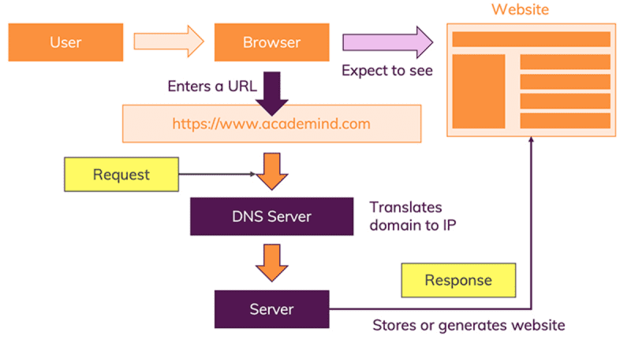
How does the web work?

Slide 2
Web Page Process
1. Request a page using its URL
2. Browser sends HTTP request to server
3. Server returns the file (or a “404 Not Found” message)
4. Browser looks at the HTML document. If there are external files (like images or style sheets), it contacts the server again for each resource
5. The server returns the additional files, and the browser assembles the final page

Slide 3
What do you need to be a web developer?
While learning the foundational skills to become a Web Developer is relatively straightforward, becoming a good Web Developer can be more challenging, requiring ongoing learning and effort .
To become a Web Developer, you should have an understanding of HTML, CSS, and JavaScript.
It's also recommended to learn about CSS frameworks.
Developing these fundamental web development skills will give you the foundation and logic for communicating with programming languages.

Slide 4
Why did you choose to learn web development?
Web development gives to me the opportunity to express myself creatively on the internet. I have an idea about web dev and i would like to try it as my discover of web dev skills. Web dev is a fun, creative experience

